Slide 1
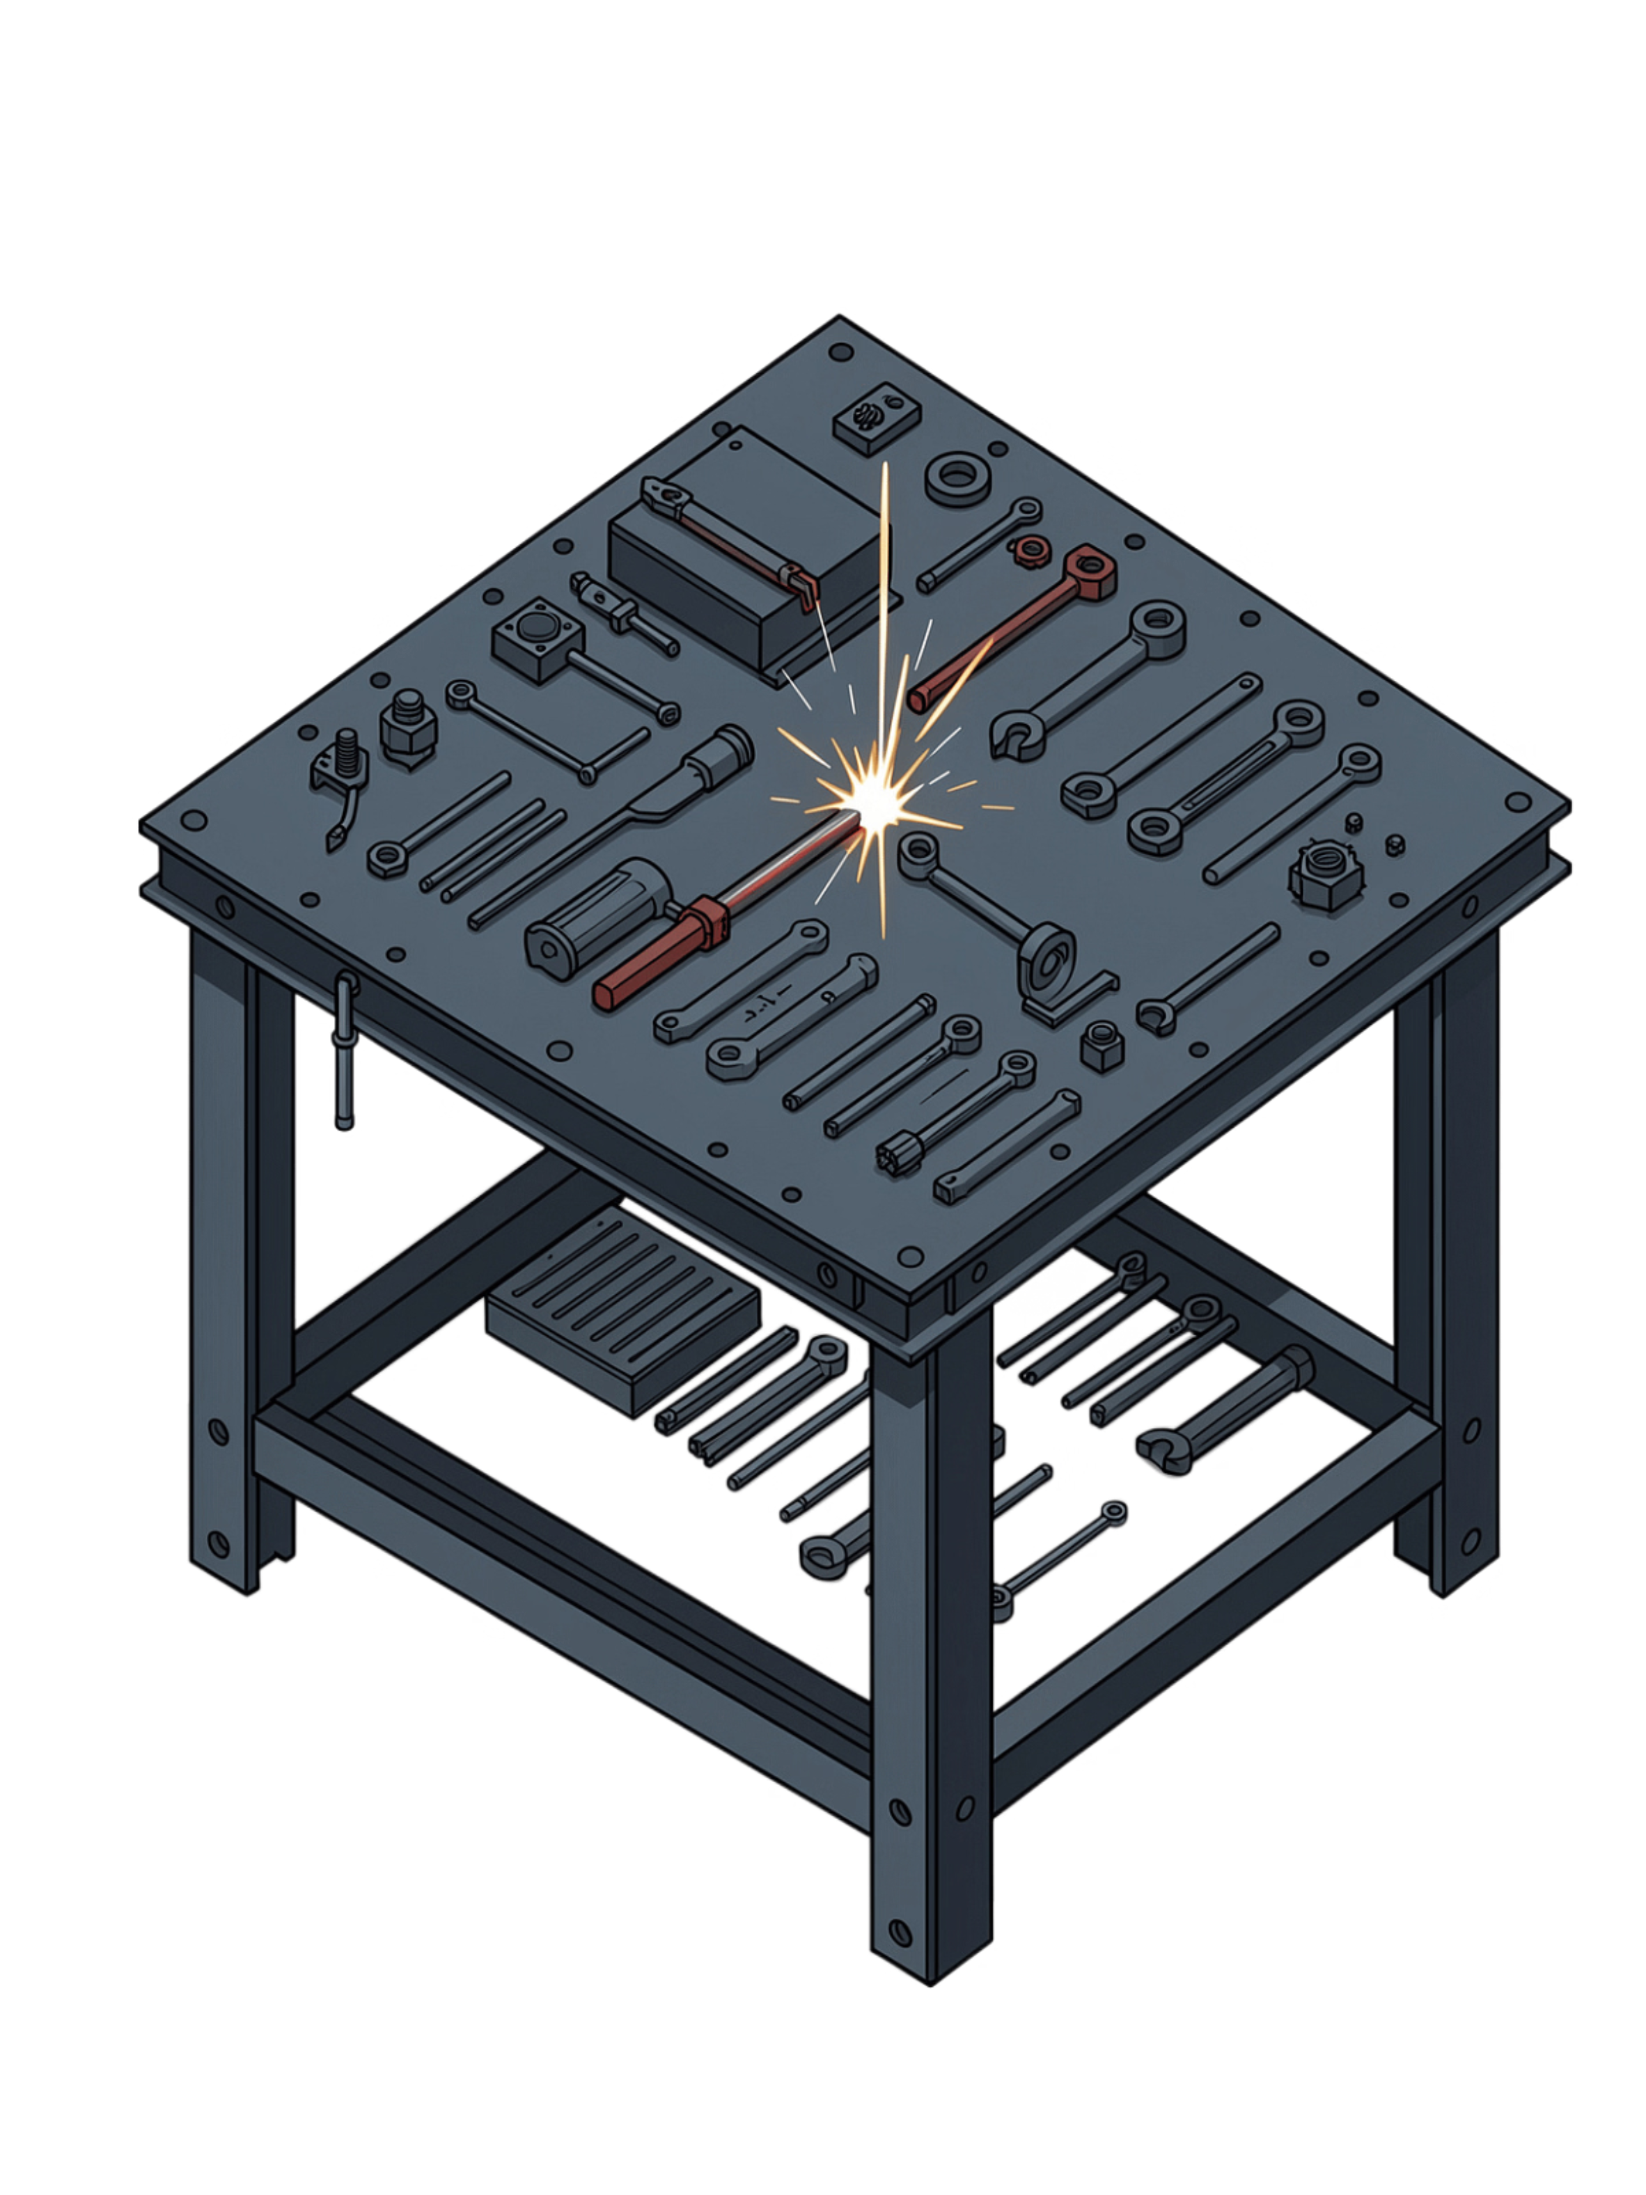
Welding Bench Fabrication Project
Gas Welding Workstation — Manual Metal Arc Welding (MMAW)

Slide 2
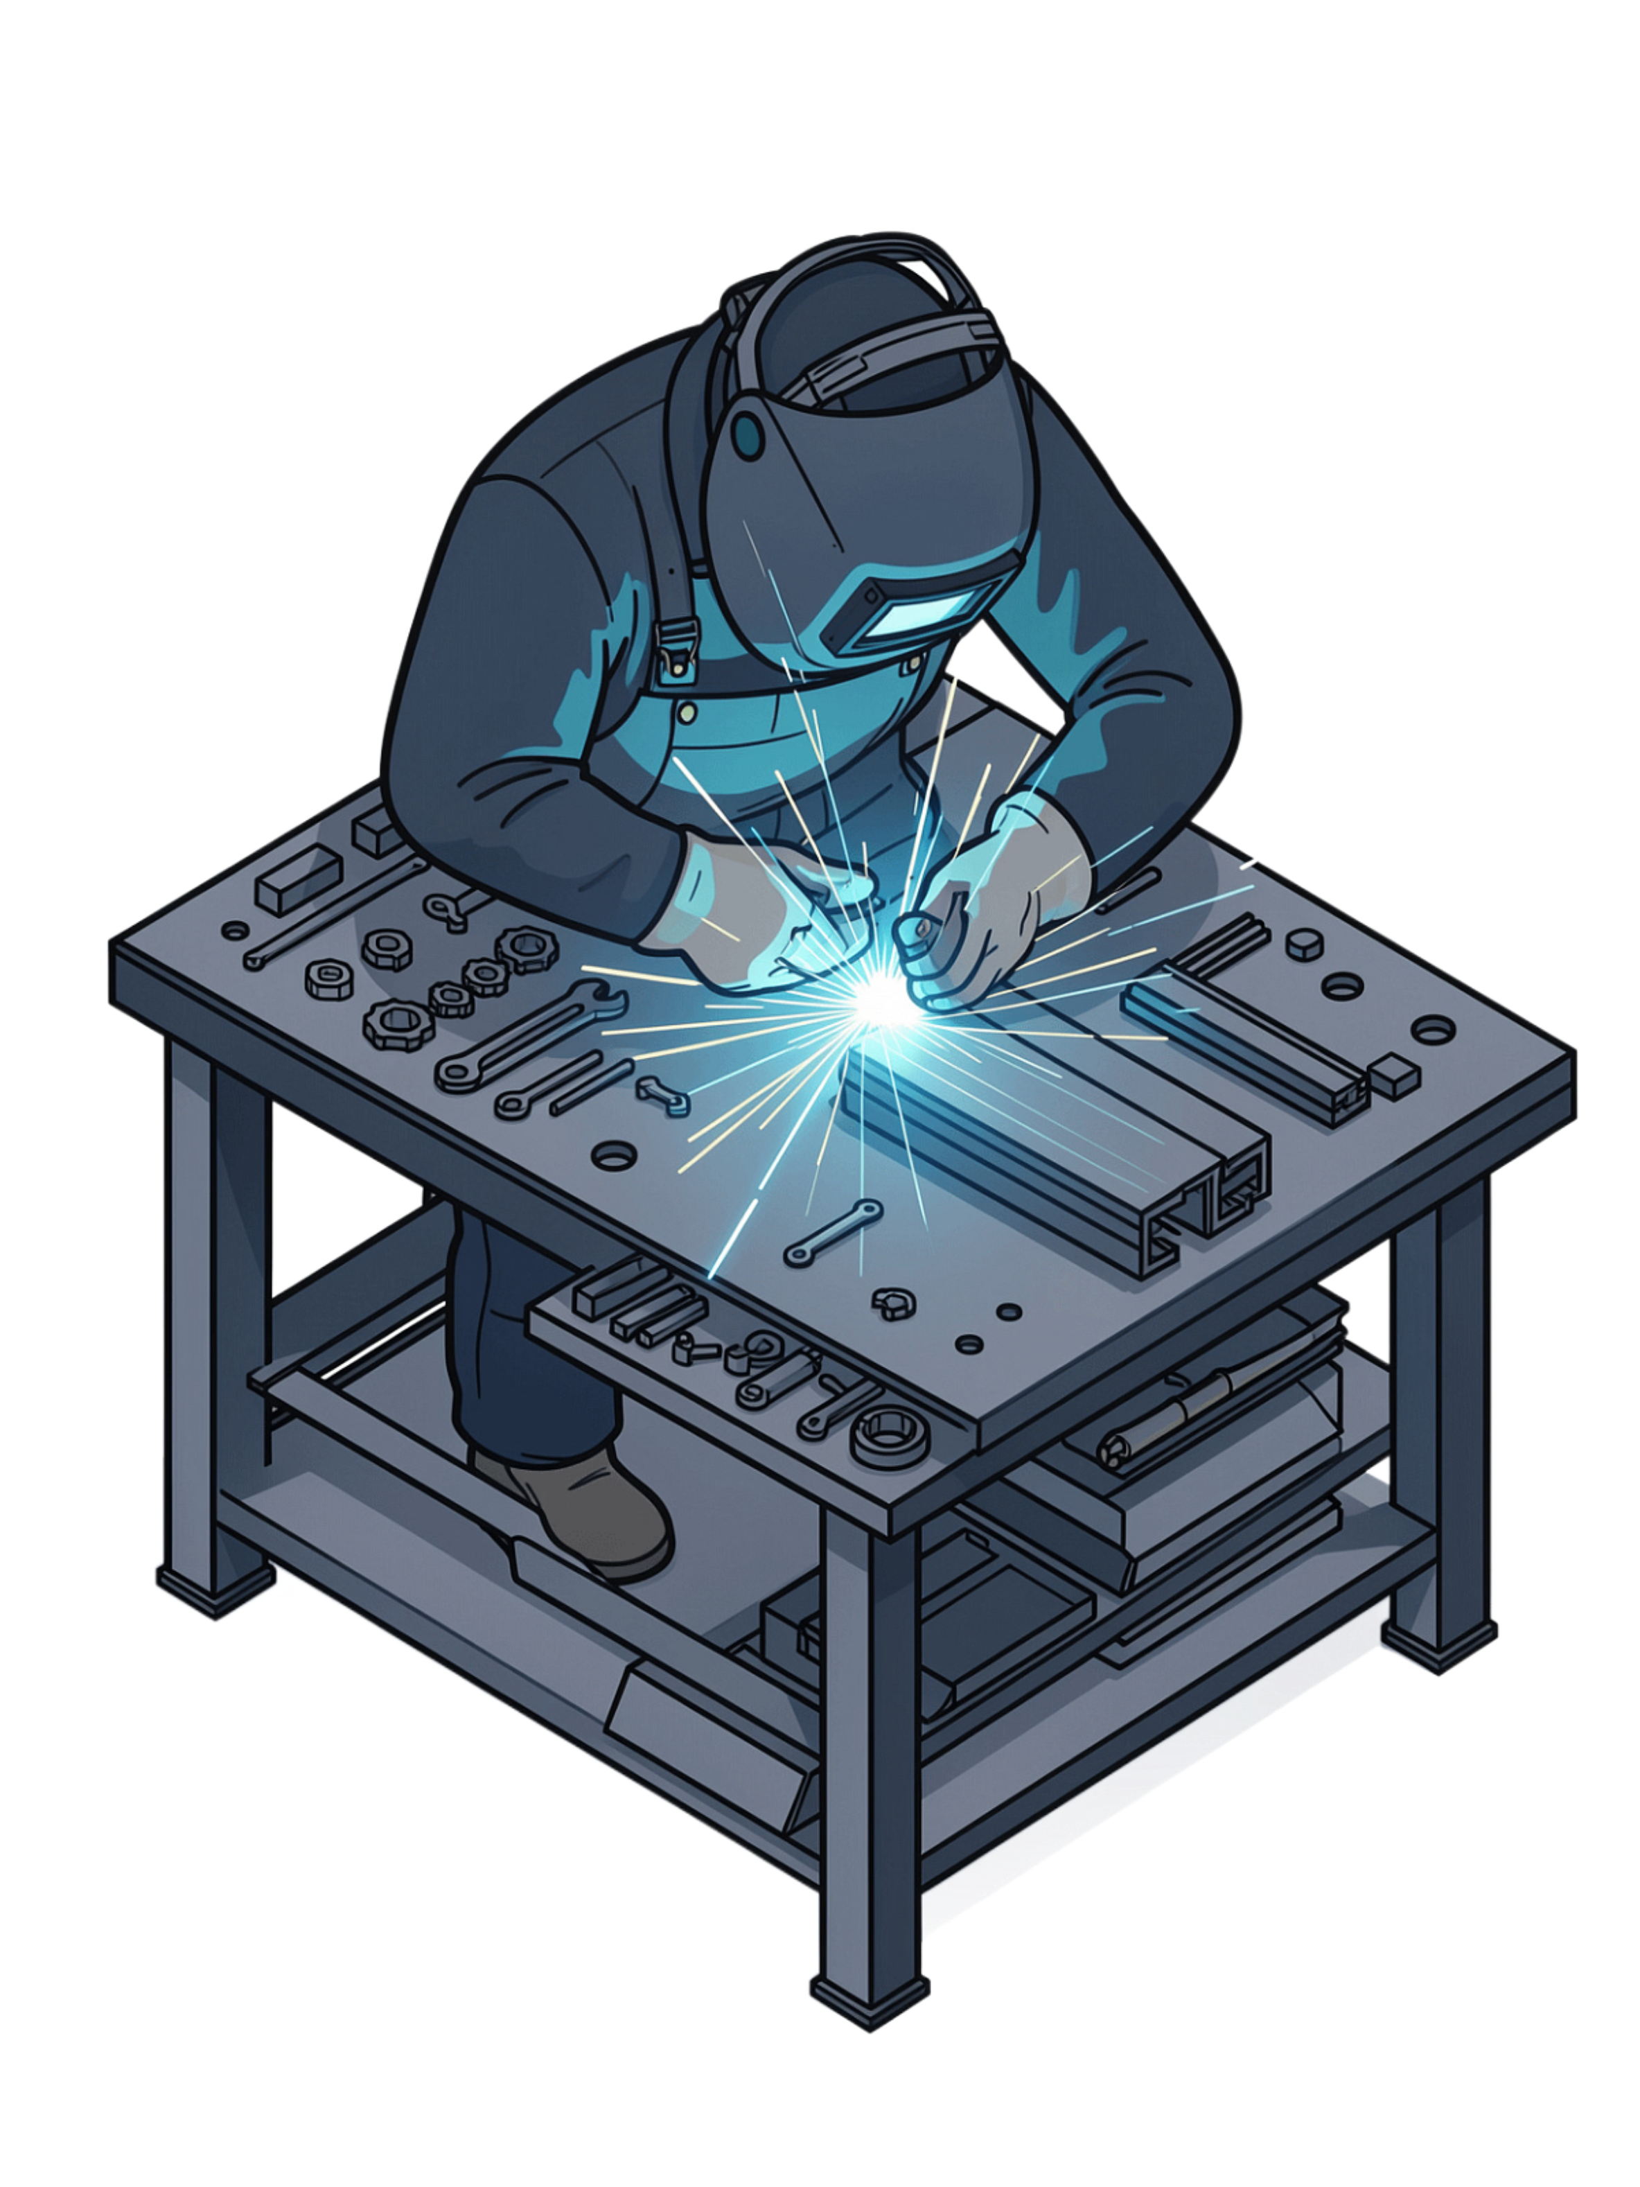

Project Overview & Objectives
Purpose
Design and fabricate a portable gas welding demonstration bench using Manual Metal Arc Welding (MMAW).
Primary Use
Light fabrication, welding practice, and gas welding demonstrations in training and workshop environments.
Key Requirement
Heat-resistant, stable work surface with proper grounding and clamping capability for safe operation.

Slide 3
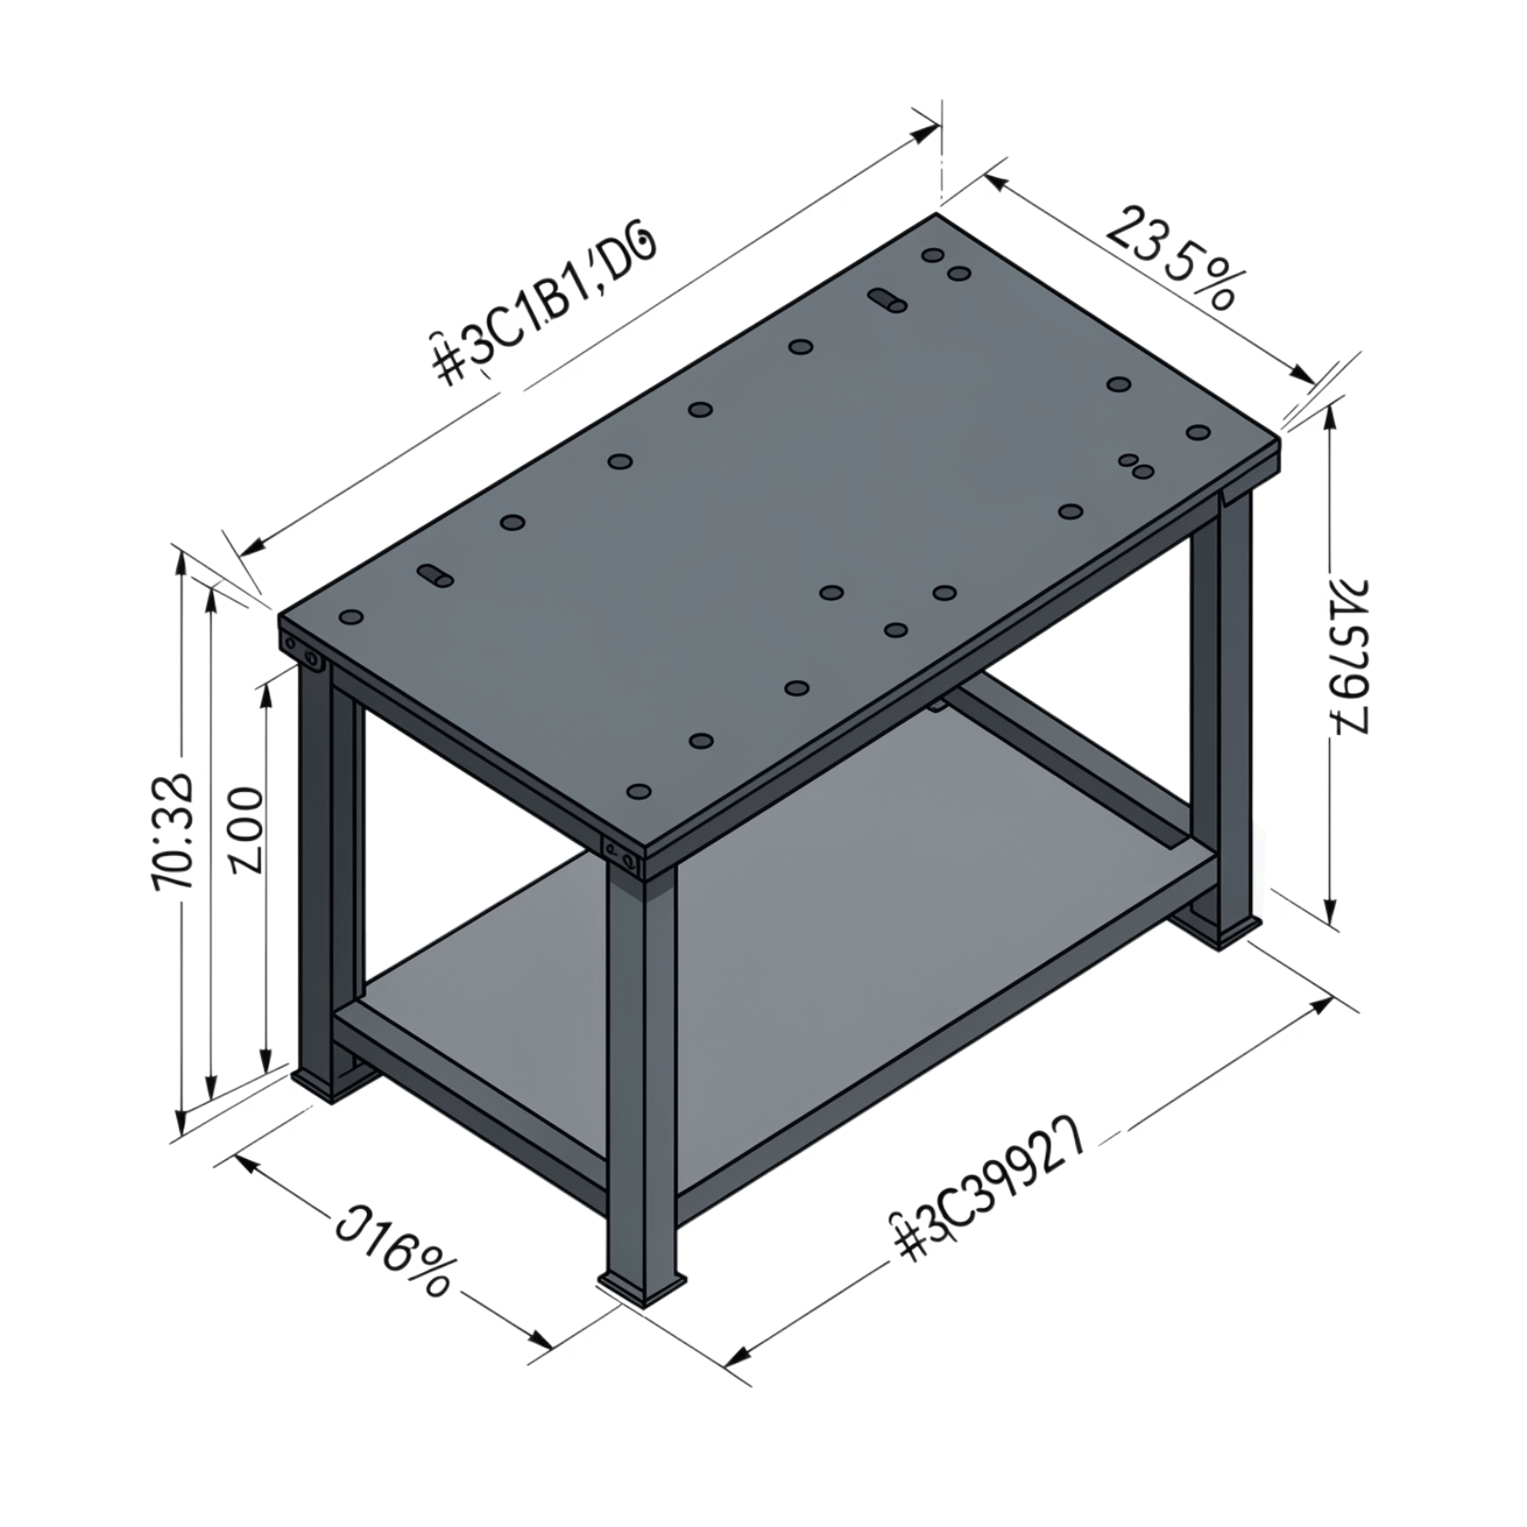
Bench Specifications & Dimensions
Overall Dimensions
Length: 1200mm
Width: 600mm
Height: 900mm
Surface & Structural
Top plate: 1200 × 600 × 6mm mild steel (A36)
Working height: 900mm (ergonomic, standing)
Load capacity: 500kg distributed load
Tolerance: Flat, square, level within ±2mm

Slide 4
Materials Bill of Quantities
Component | Specification | Quantity
Structural Frame | 75×50×2mm RHS (Rectangular Hollow Section) | 8 metres
Top Surface | 1200×600×6mm mild steel plate (A36) | 1 sheet
Angle Bracing | 50×50×5mm angle iron | 4 metres
Fasteners | M10 bolts, nuts, washers (caster mounting) | As required
Caster Wheels | 100mm swivel casters (2 locking) | 4 units
Welding Rod | E7018 (3.2mm) for frame assembly | 5 kg

Slide 5
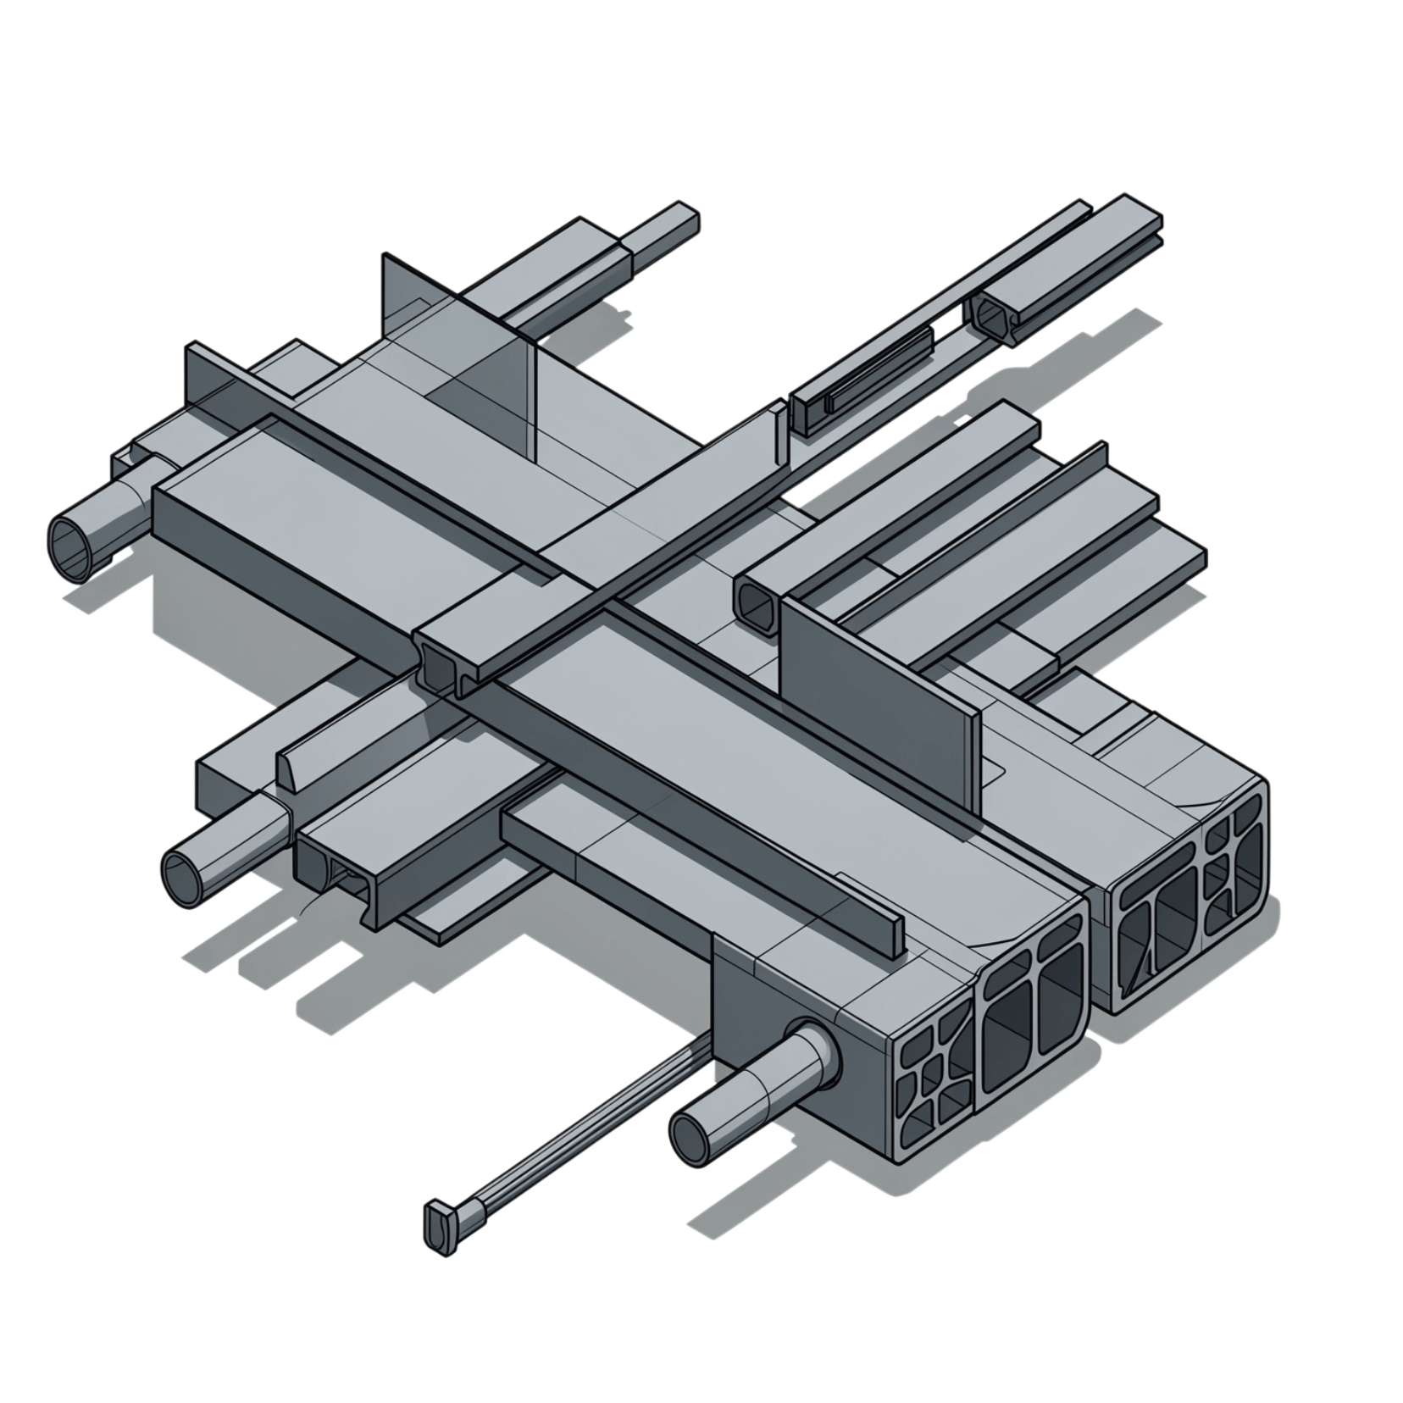
Cutting List for Frame Components
Longitudinal Beams (×2)
Lateral Beams (×2)
Vertical Supports (×4)
75×50×2 RHS @ 1150mm — 45° angle both ends
75×50×2 RHS @ 550mm — 45° angle both ends
75×50×2 RHS @ 775mm — square cuts
Diagonal Bracing (×4)
Top Mounting Rails (×4)
50×50×5 angle @ 775mm
50×50×5 angle @ 1150mm and 550mm

Slide 6
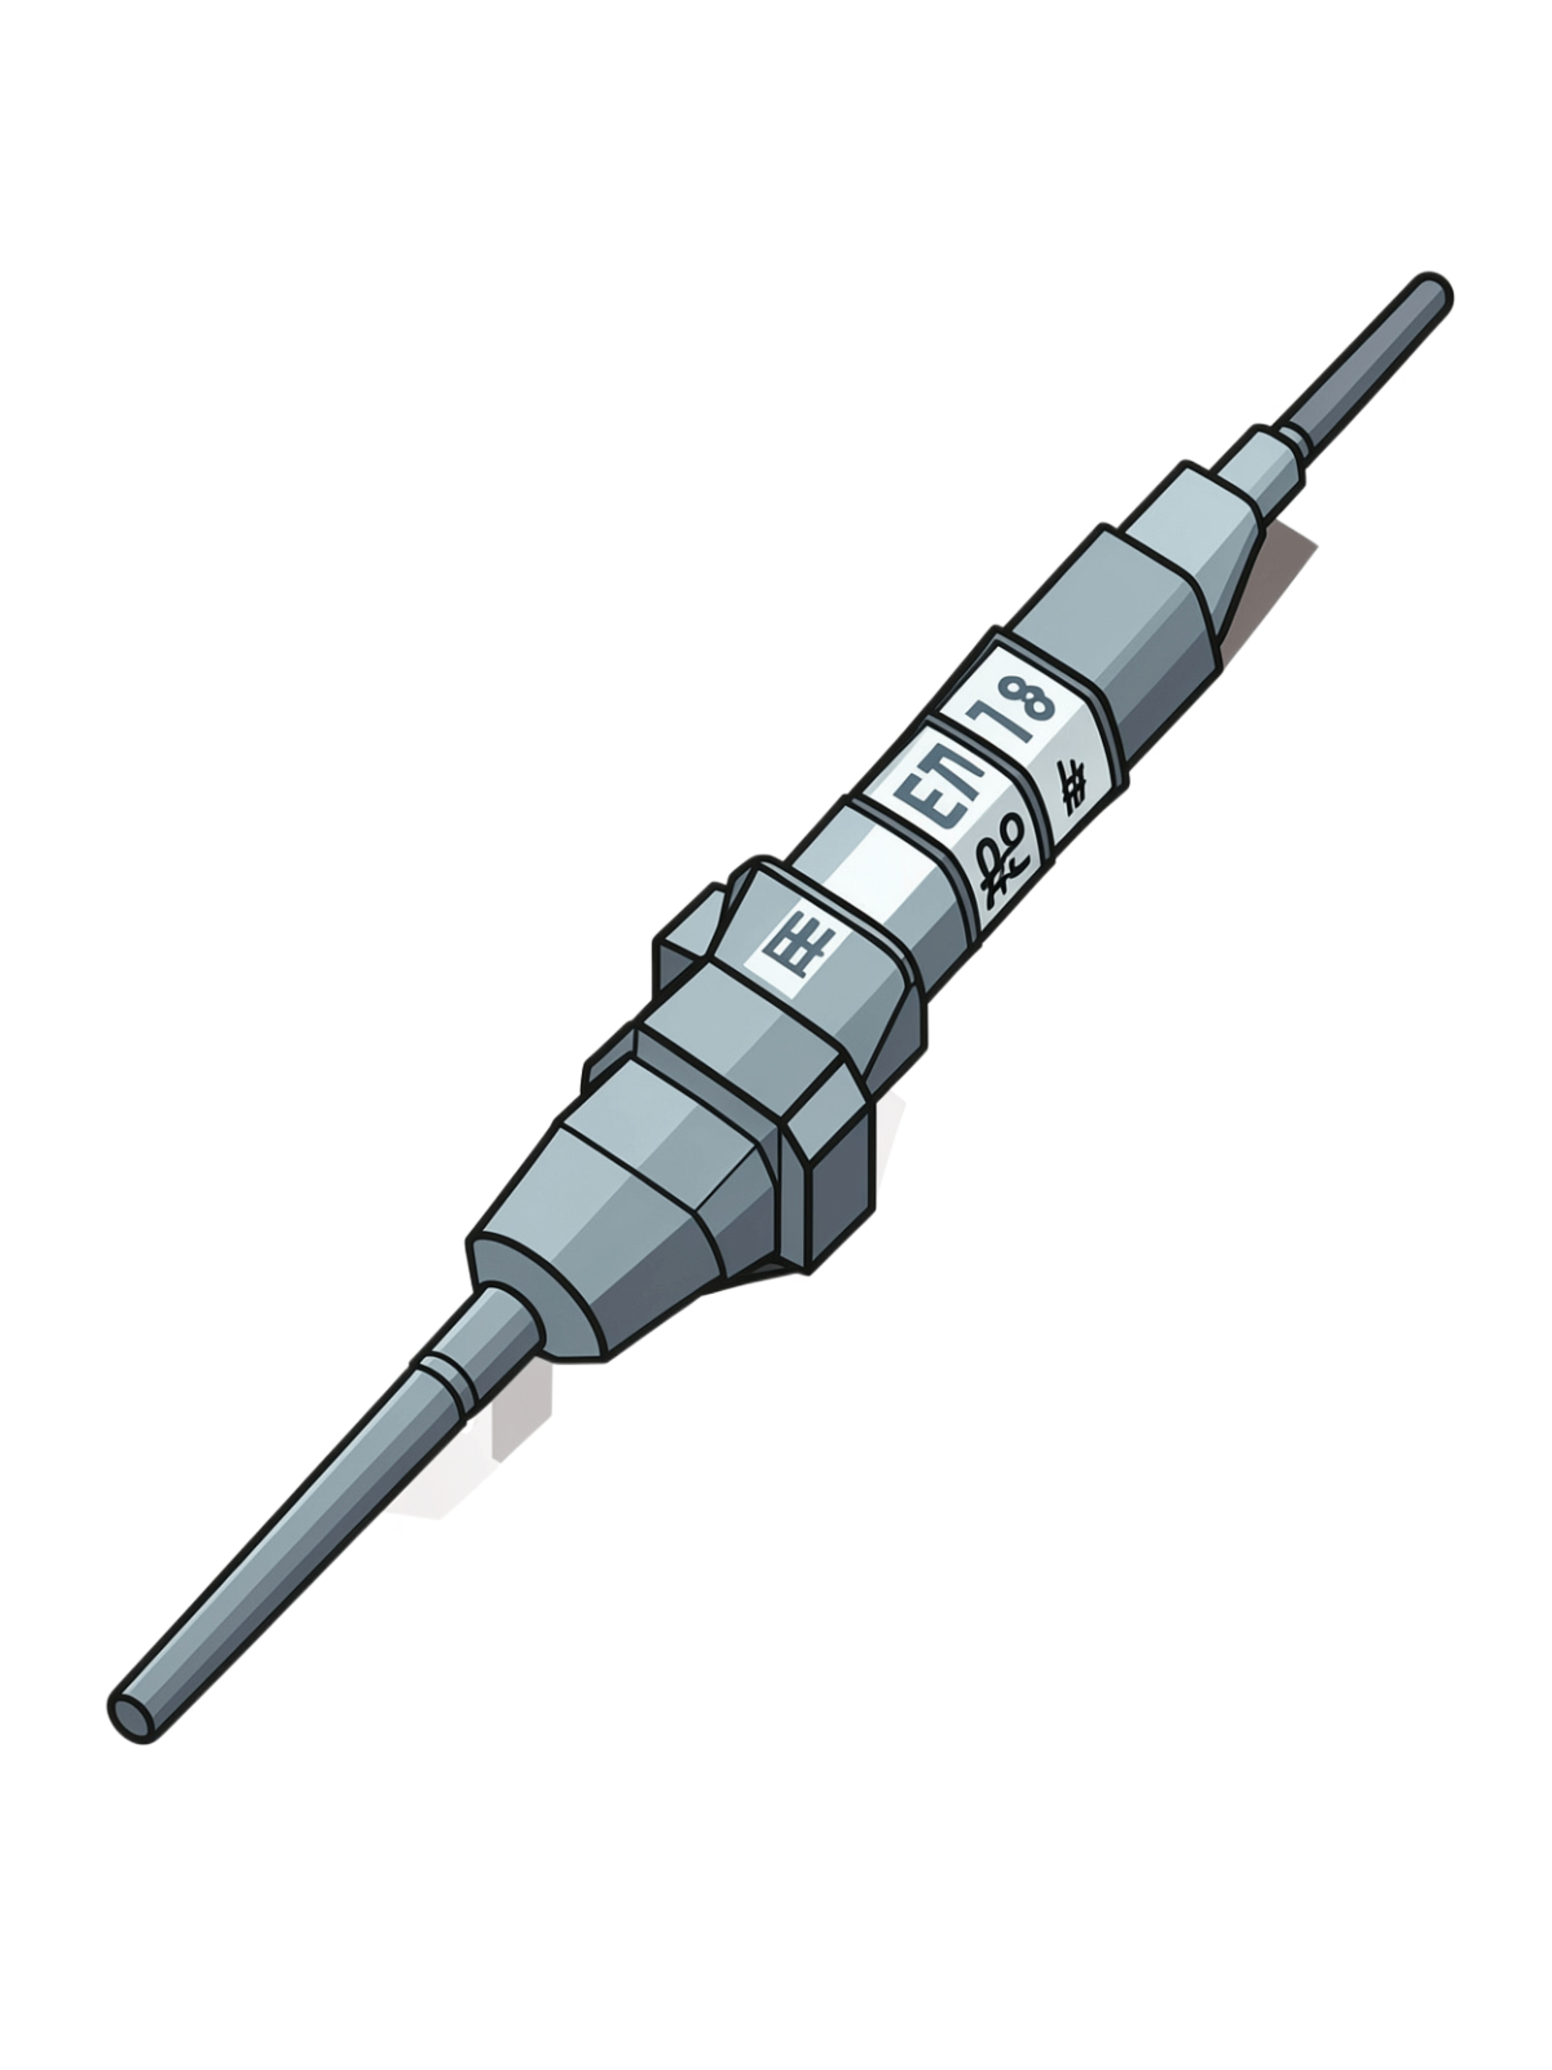
MMAW Electrode Selection & Parameters
E7018
Electrode Type
Low hydrogen, all-position flux-coated rod — no shielding gas required
3.2mm
Diameter
Standard 1/8" diameter for structural frame work
90–130A
Amperage Range
Adjust for welding position — lower for overhead, higher for flat
DC+
Polarity
Electrode positive for deeper penetration and superior fusion

Slide 7
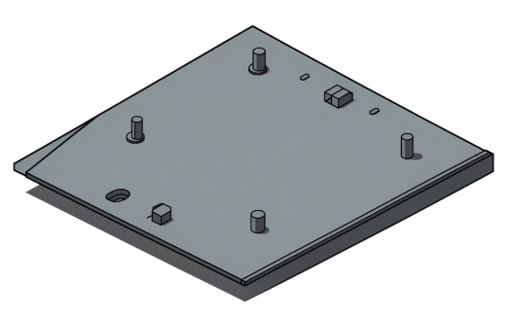
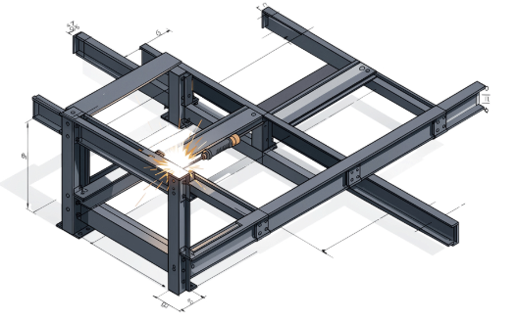
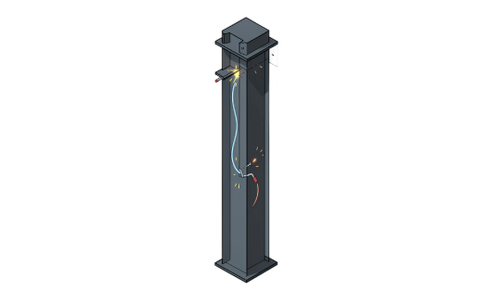
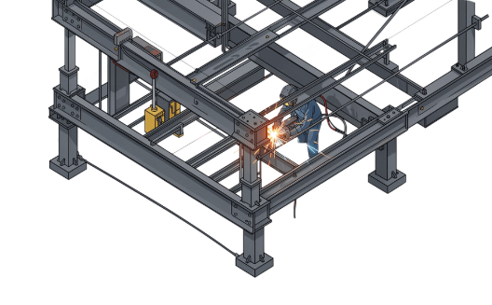
Welding Positions & Techniques
1F/1G — Flat
2F/2G — Horizontal
3F/3G — Vertical
4F/4G — Overhead
Top surface welds. Gravity assists the puddle. 100–110A. Easiest position — use for top plate attachment.
Side frame welds. Control travel speed to prevent sagging. 110–120A.
Vertical supports. Weld upward, manage puddle carefully. 100–115A.
Underside bracing. Most demanding position — maintain short arc. 90–100A.

Slide 8
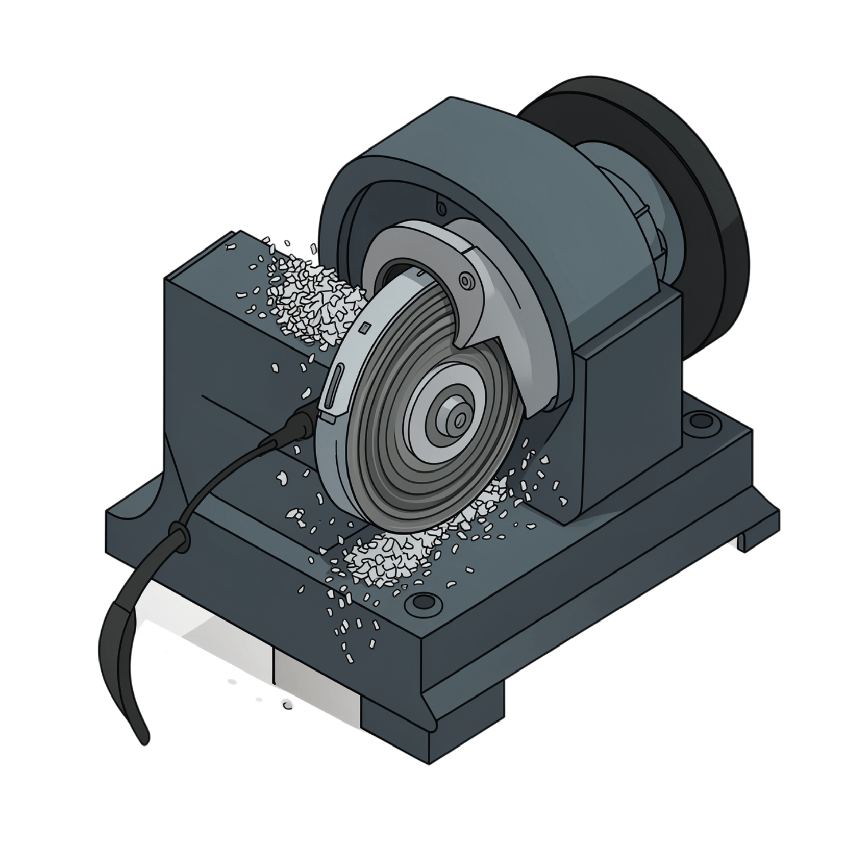

Pre-Fabrication Preparation
Surface Cleaning
Remove mill scale using a wire brush or angle grinder with a flap disc. Clean metal ensures proper arc striking and full fusion.
Fit-Up & Alignment
Tack weld all joints before full welding to verify alignment
Use a framing square on all 90° corners before tacking
Apply G-clamps to hold components firmly during tack welds
Adjust fit-up while tacks are still adjustable — before full passes
Always verify squareness by measuring both diagonals of each rectangular frame — they must be equal before proceeding to full welds.

Slide 9
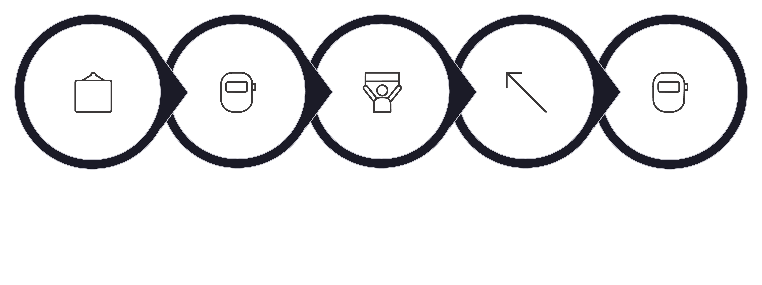
Frame Assembly Procedure
Assemble Base
Install Supports
Tack Corners
Add Bracing
Full Weld
Follow this sequence strictly — verifying squareness and plumb at each tack stage prevents compounding errors that are difficult to correct once full welds are completed.

Slide 10
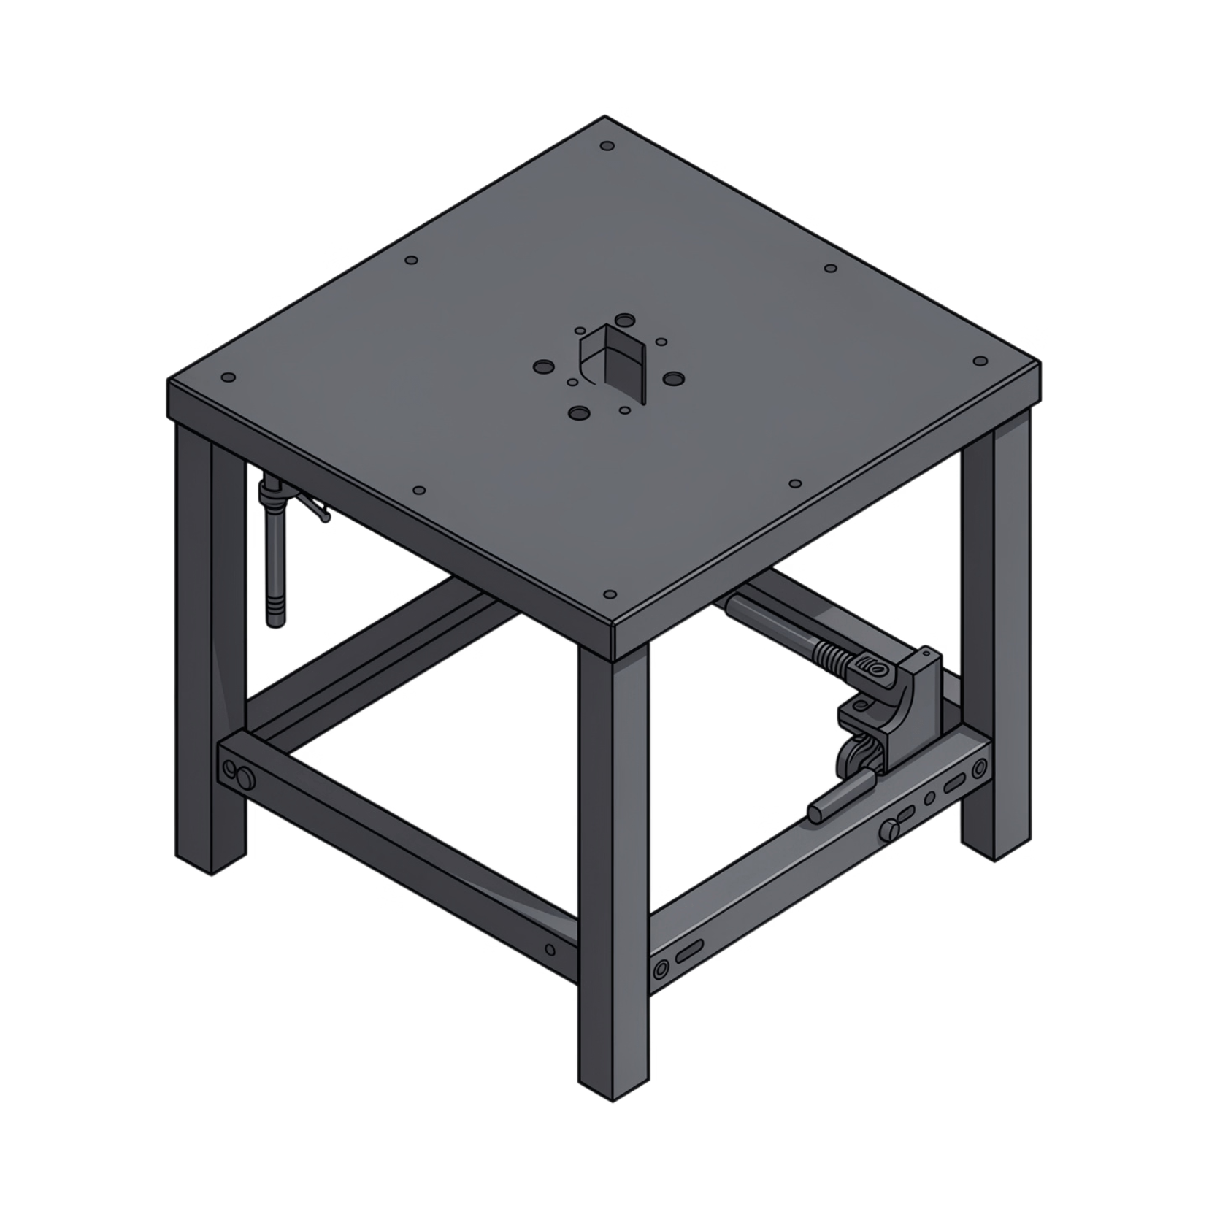

Top Surface Installation & Finishing
Mounting & Alignment
Bolt 6mm steel plate to frame top using M10 bolts through pre-drilled holes
Ensure plate is level and flush on all edges within ±2mm tolerance
Grounding & Surface Finish
Attach earth clamp lug to underside of plate for welding circuit continuity
Grind smooth any high weld spots on the top surface
Apply rust-preventive primer coating to all bare steel surfaces
Final bench should be flat, level, and square within ±2mm — verify with a precision level before marking the project complete.

